Slide 1
UNIT - V
WEB INTERFACE DESIGN

Slide 2
OVERLAYS
By
Summya Mehveen [2103A51109]
Shiva Krishna [2103A51390]

Slide 3
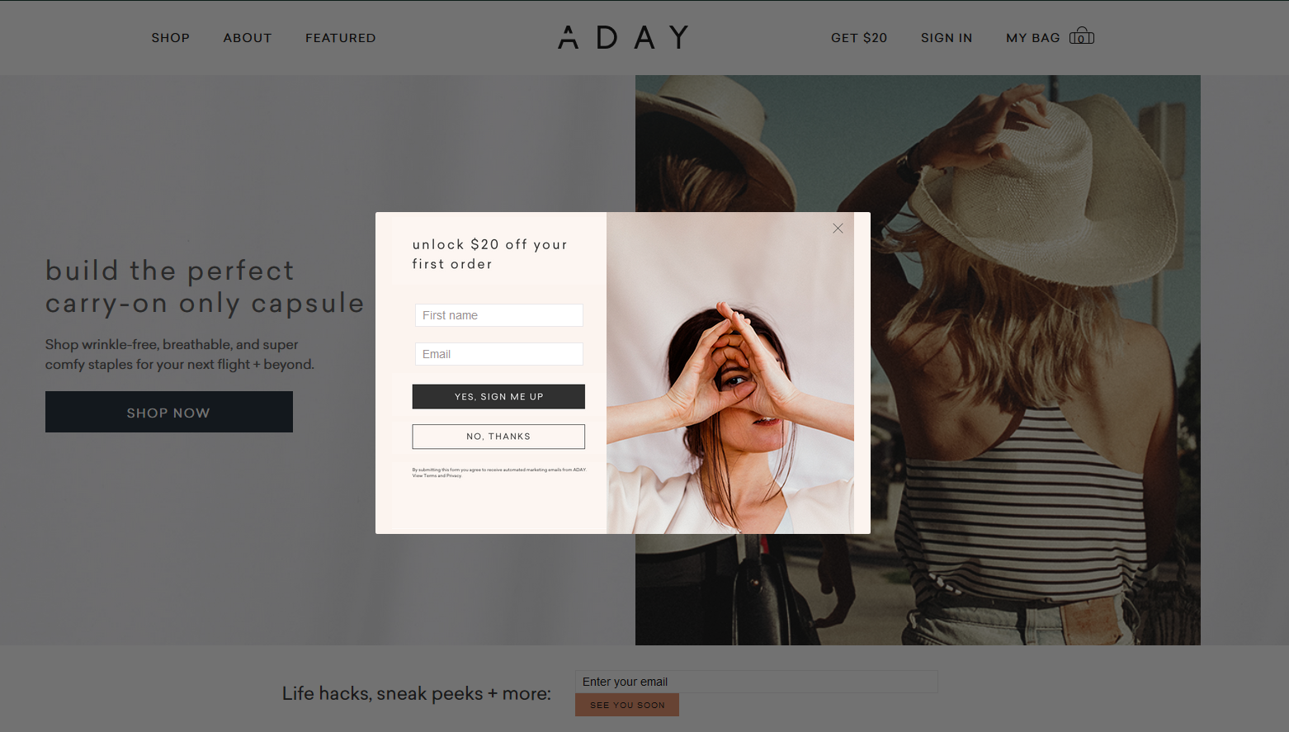
CONTENTS
Overlays
Types of Overlays
Design Overlays
Detail Overlays
Input Overlays

Slide 4
Overlays – Introduction
Overlays are just lightweight pop-up’s.
Different from browser pop-up’s.
Browser pop-up’s are created in new window. Whereas, lightweight overlays are shown within browser page.
Using Flash/Ajax style techniques (Dynamic HTML) we can present a light overlays within page itself.

Slide 5
Browser pop up’s - Drawbacks
They are Expensive.
Hard to control.
Slow while loading – due to network latencies.
Display in new browser window – windows may take and consume chunk of system resources to display.
Display’s browser interface controls.
eg : URL Bar – due to security reasons URL is fixed permanently on any browser pop-up window.

Slide 6
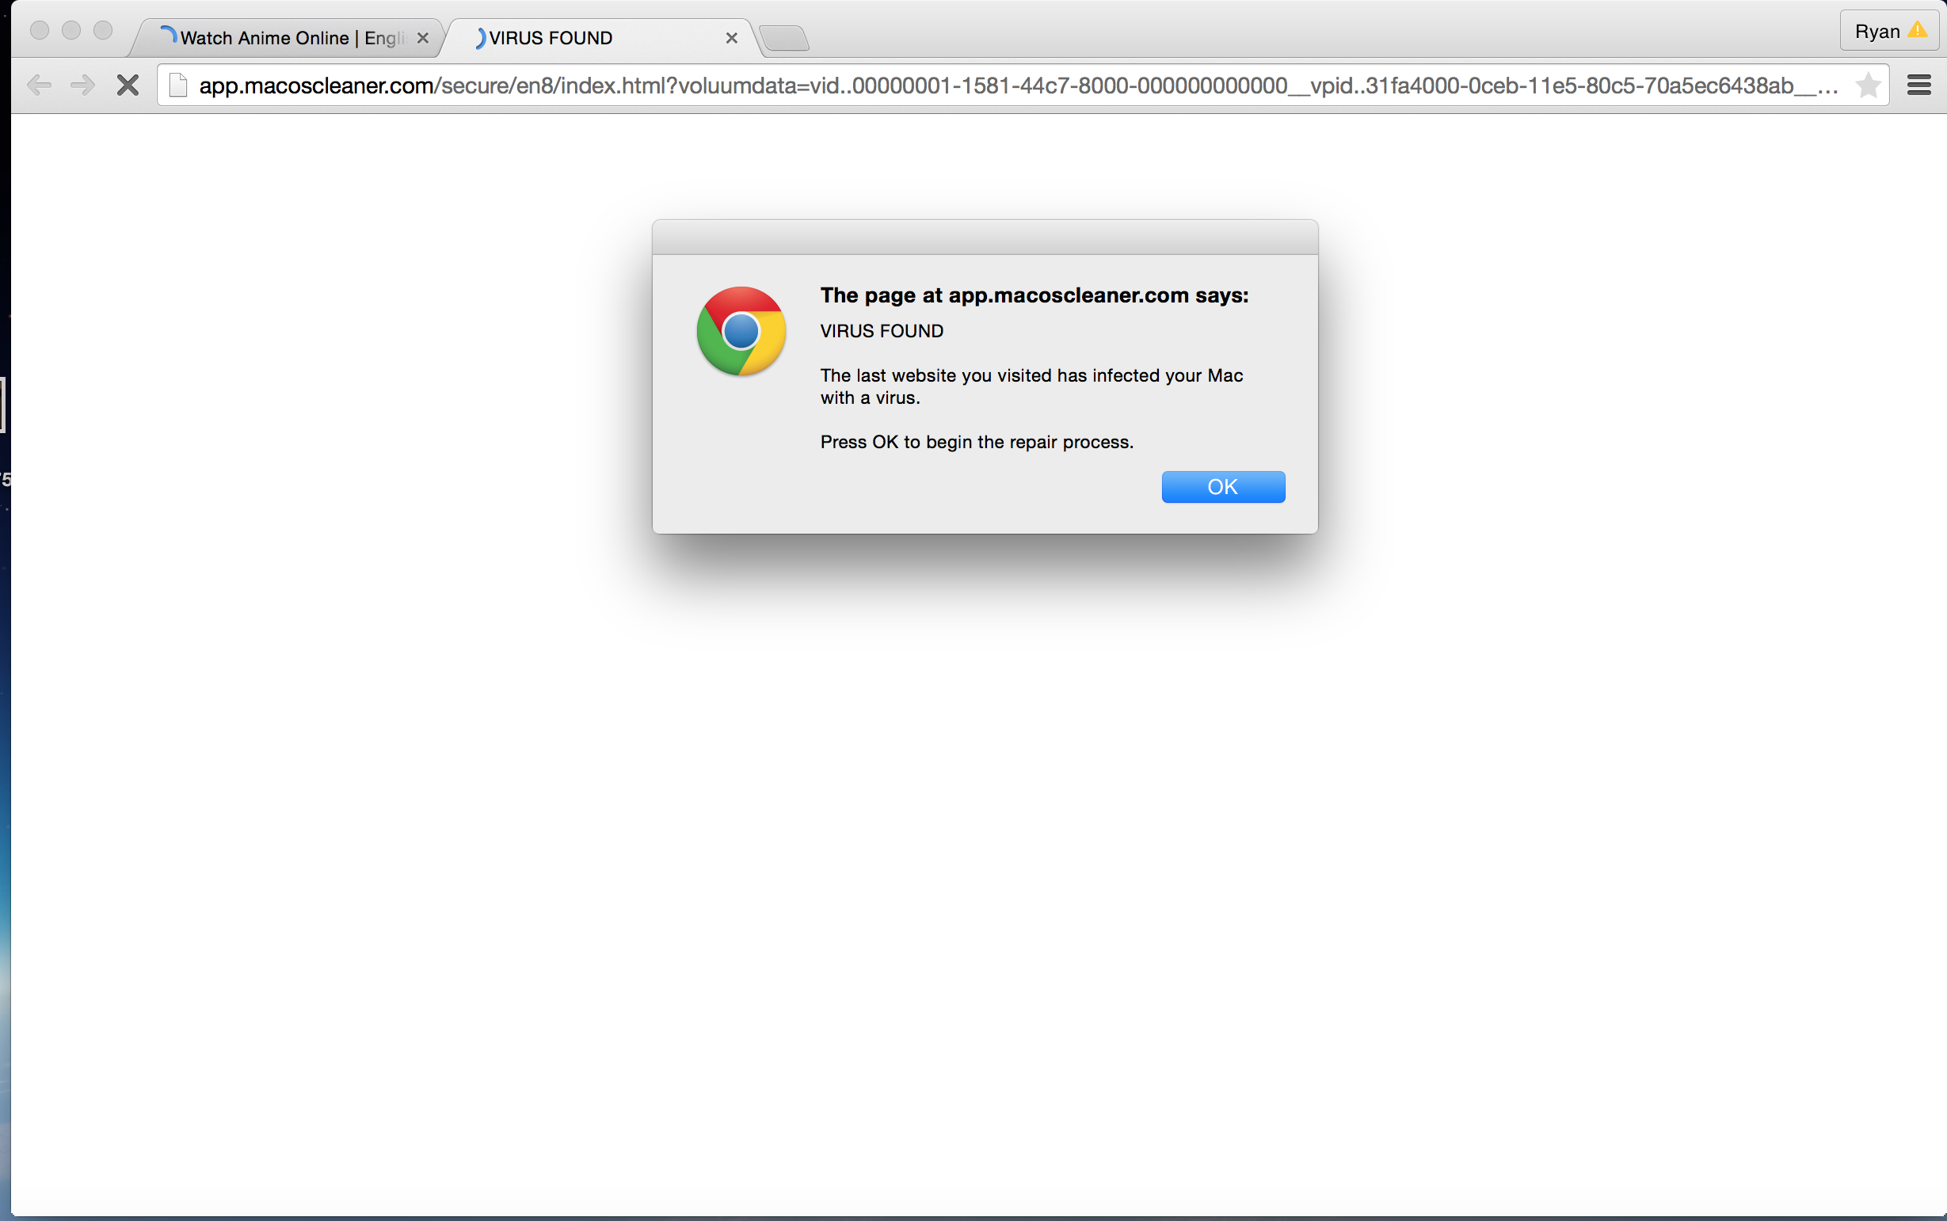

Slide 7
Lightweight overlays - Advantages
Are lightweight in page objects.
Inexpensive to create and fast to display.
Interface is controlled by web application not by browser.
Can be activated directly by user events – like clicking an action or hovering over objects.
Visually integrated into application’s interface – creates complete control over the visual style for overlays.

Slide 8
Lightweight overlays – Uses
Lightweight overlays are used for:
Asking questions.
Obtaining input from input fields.
Introducing multiple new features.
Indicating progress of an action.
Giving instructions and revealing information.

Slide 9
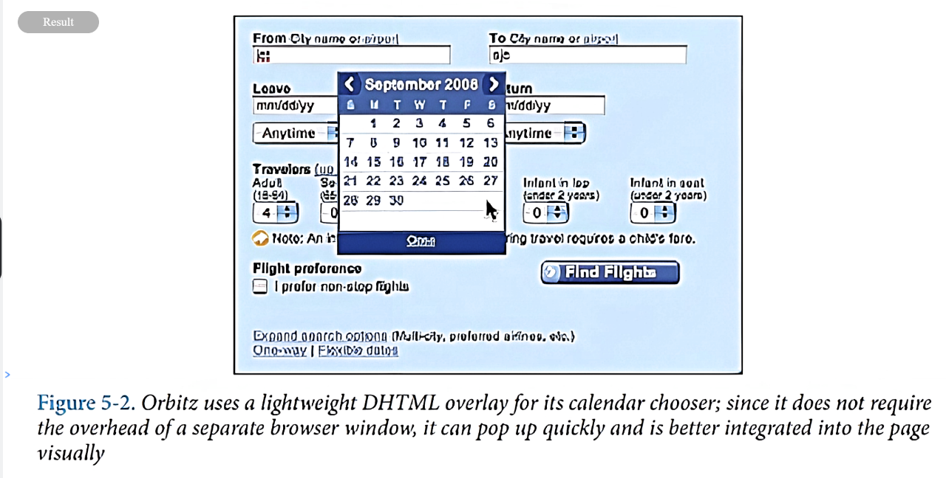

Slide 10
Types of Overlays
Overlays are specifically 3 types:
Dialog Overlays
Detail Overlays
Input Overlays

Slide 11
1. Dialog Overlays
Replace the old style dialog browser pop –up’s.
Inform users about critical information, require users to make decisions, or involve multiple tasks.

Slide 12
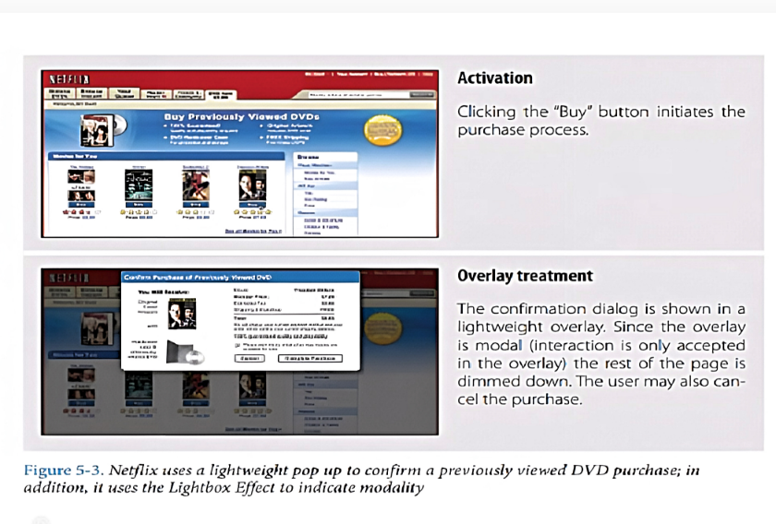
Dialog Overlay - Example

Slide 13
Dialog Overlay - Considerations
As overlay is lightweight pop up the conformation can be displayed more rapidly.
Need to consider some factors as application has complete control over its look and placement.
Lightbox Effect
Modality

Slide 14
Dialog Overlay – Considerations- Lightbox Effect
Provides a backlit area to view slides in photography.
In web, it makes overlay brighter than background by dimming the background.

Slide 15
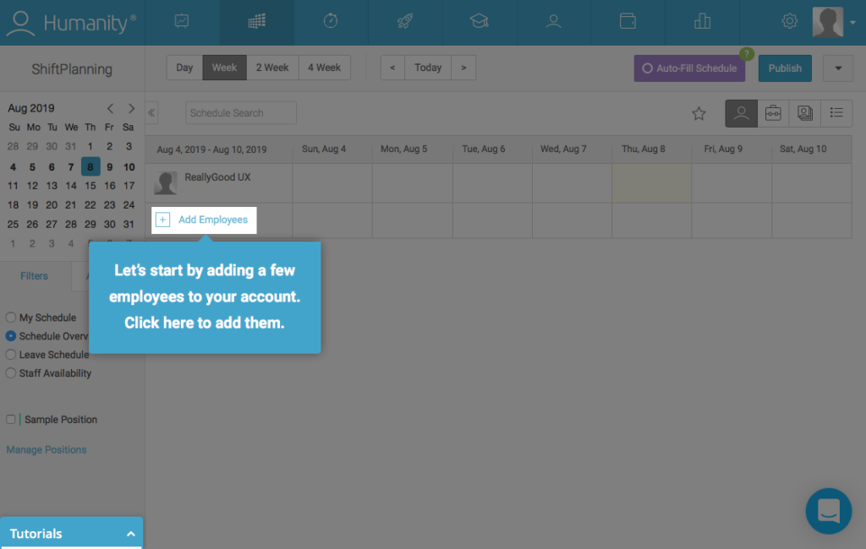

Slide 16
Dialog Overlay – Considerations- Lightbox Effect(cont.)
Useful when Dialog Overlay contains information that user should not ignore.
If overlay contains optional information then lightbox effect should not be used.

Slide 17
Dialog Overlay – Considerations- Modality
Whether the overlay is interactive or not?
Can be modal and non-modal.

Slide 18
Dialog Overlay – Considerations- Modality(cont.)
Modal Overlays
Require user to interact with overlay interface before he return to application page.
Tip : Combine with lightbox effect – dimming background cues so that user can understand that this portion of interface cannot be interacted.

Slide 19
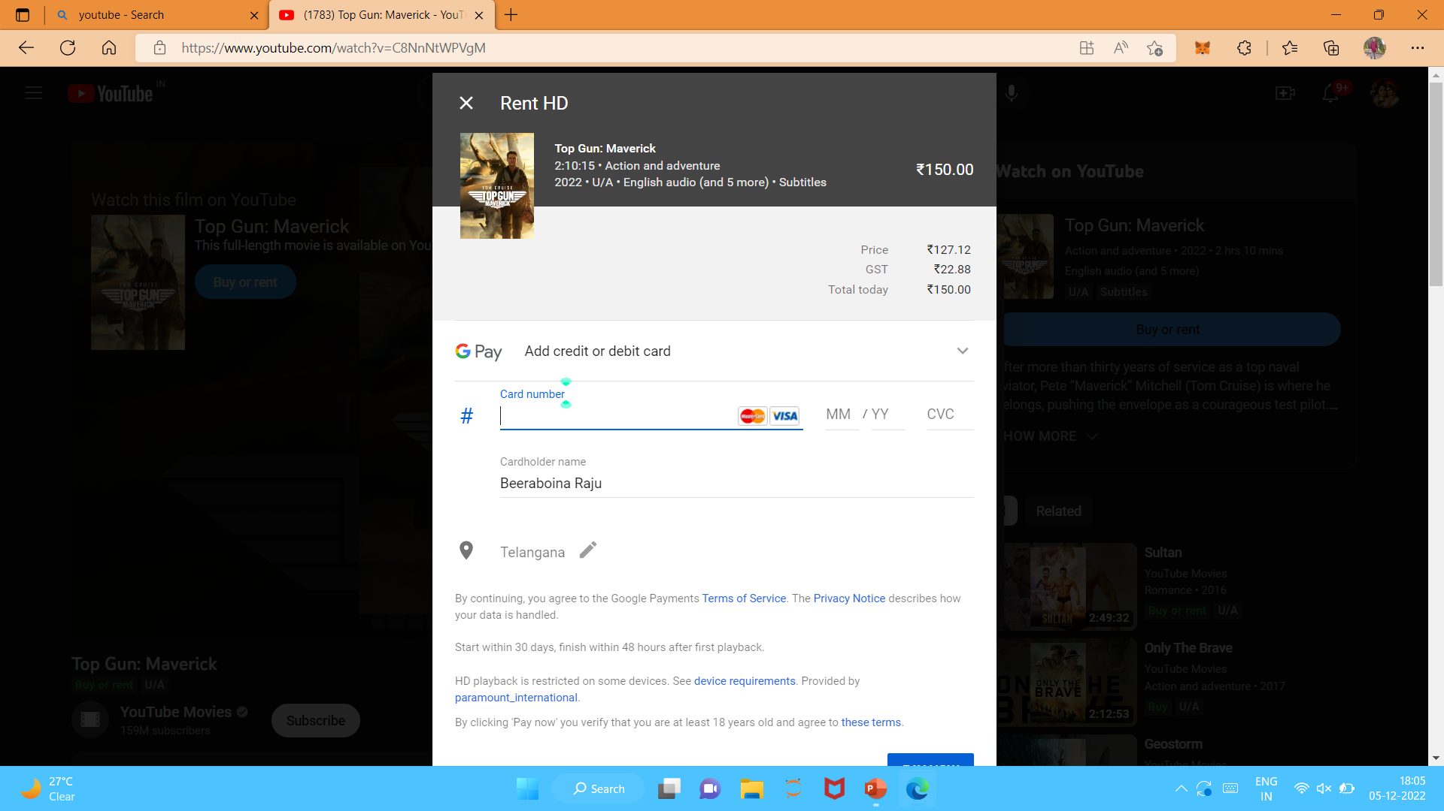

Slide 20
Dialog Overlay – Considerations- Modality(cont.)
Non- Modal Overlays
Does not require much interaction with users.
Lightbox effect is not needed for most of non – modal overlays.
Example: in Netflix, when DVD is added
Tip : allow user to click anywhere in the overlay to return to application.

Slide 21
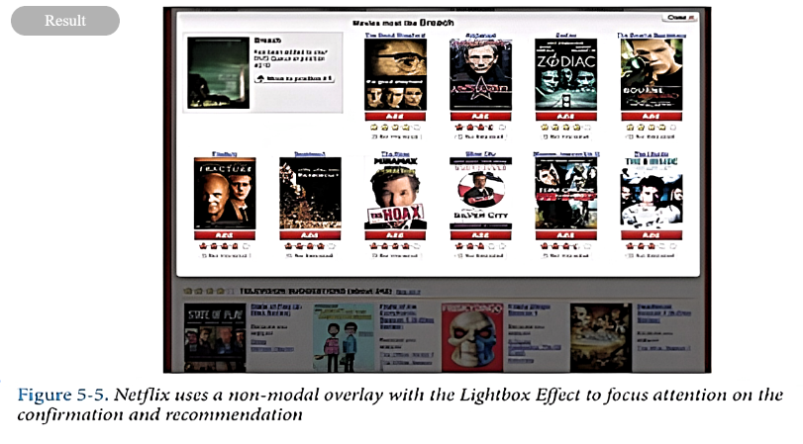
Dialog Overlay – Considerations- Modality(cont.)
Example: in Netflix, when DVD is added to user’s shipping queue conformation overlay is shown.

Slide 22
Dialog Overlay – Stay in the flow
Although they are visually good and inexpensive.
They can be:
Tempting to use too freely.
Breaks user’s actual work flow.

Slide 23
Dialog Overlay – Anti patterns : Idiot Boxes
“Don’t stop the proceedings with idiocy”
(it is egregious to interrupt user endlessly).
Creating multiple overlays may stop user’s flow.
Causes anti – patterns.
Tip : Mind the interesting moments in an interaction. They can remove the need for Idiot Boxes.

Slide 24
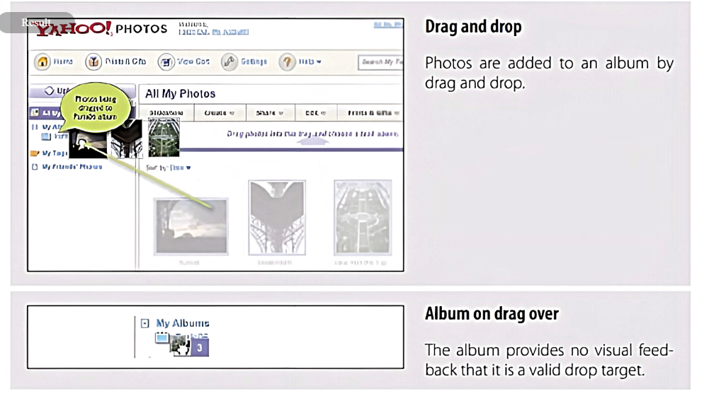
Dialog Overlay –Idiot Boxes - Example

Slide 25
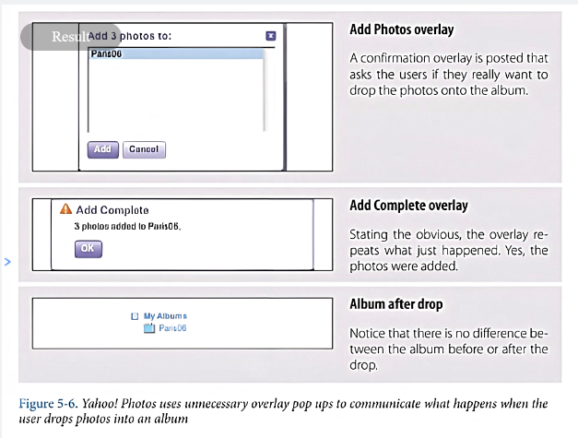

Slide 26
Dialog Overlay – Java Script alerts
Tempting to use alert mechanism built into the browser for some confirmations.
But creates two – fold problem.
Do not present themselves consistently across different operating systems.
Example:
Under Windows OS = appear centre in browser window.
Under Mactonish = slide out from title bar.
2. No way to control look and feel of alert pop up.

Slide 27
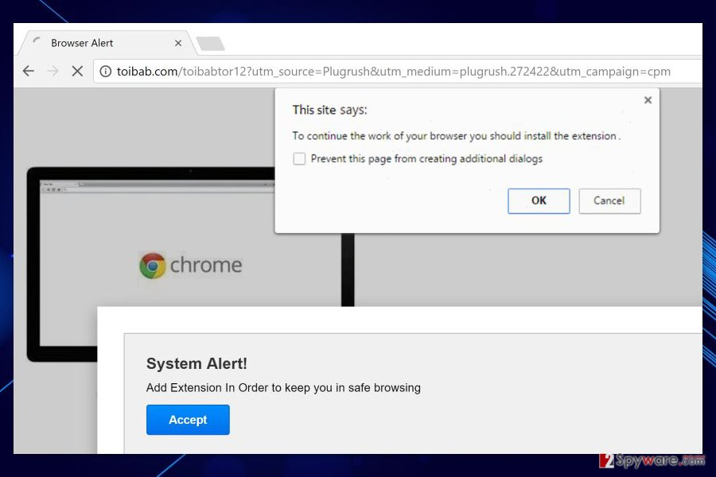

Slide 28
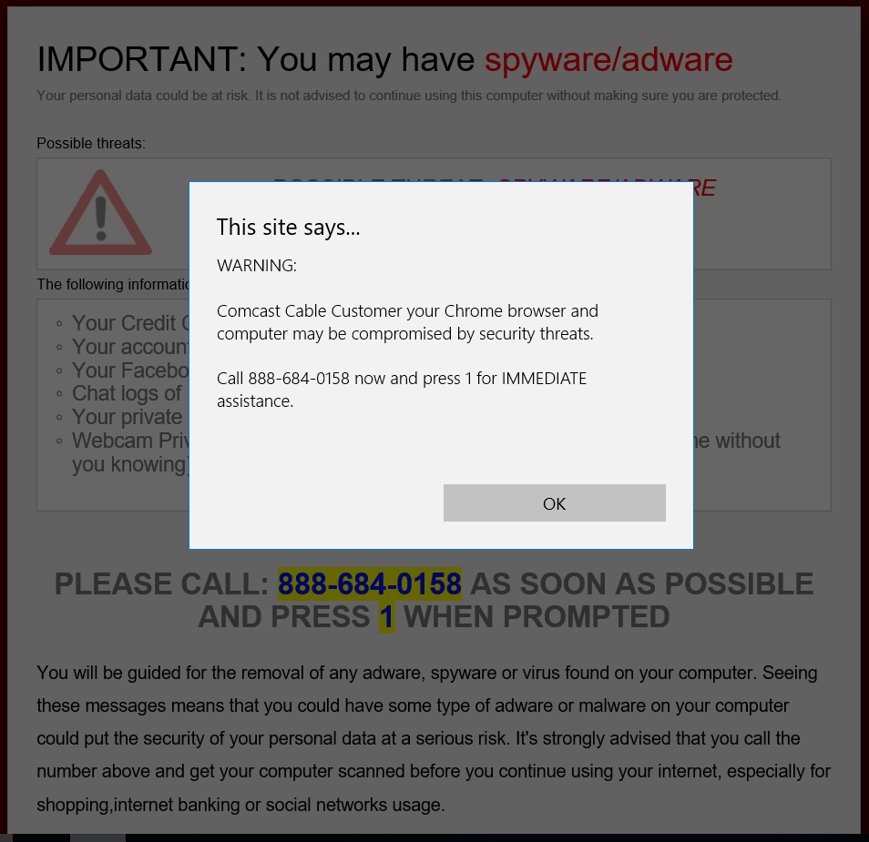

Slide 29
2. Detailed Overlays
New to web applications.
Allows an overlay to present additional information when the user clicks or hovers another link or section of content.

Slide 30
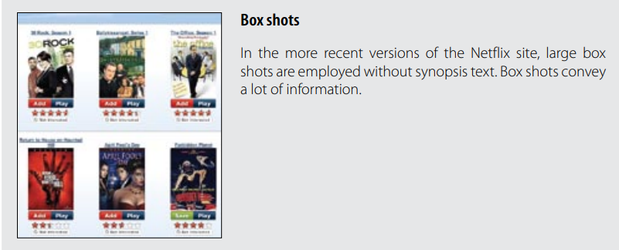
Detailed Overlay – Example
Netflix

Slide 31
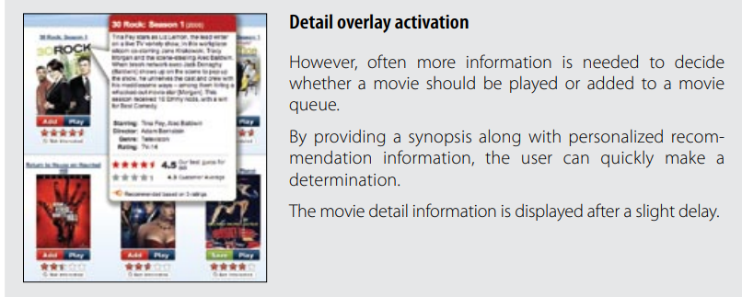

Slide 32
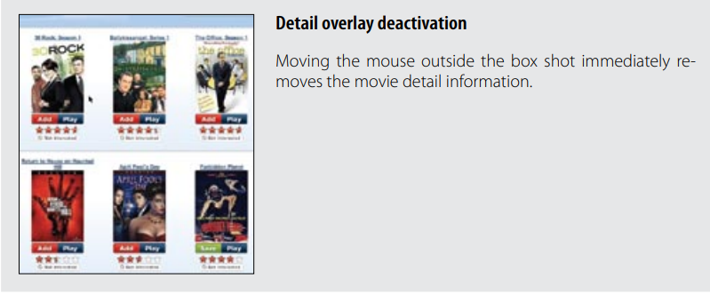

Slide 33
Detailed Overlay - Considerations
The overlay provides a nice way to reveal a synopsis for a movie.
It is like flipping over the DVD box and reading what is on the
back.

Slide 34
Detailed Overlay- Activation
Displayed when the mouse hovers over the short box
There will be about half-second delay after the user pauses on movie.
The delay prevents accidental activation.
No "CLOSE BOX"
Cursor moved aside from the boxshot, the overlay is removed immediately.

Slide 35
Tip:-
For Detail Overlays activated by a mouse hover, provide a slight delay before displaying.

Slide 36
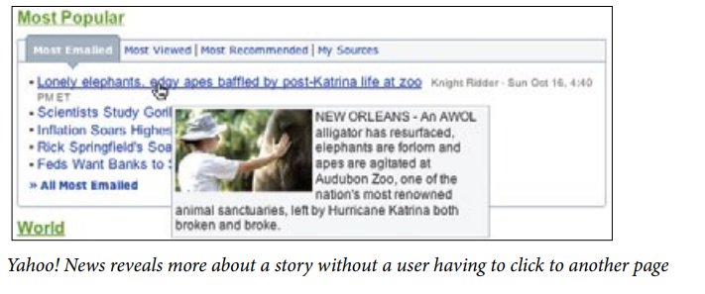

Slide 37
Detailed Overlay- Anti Patterns
Mouse Traps
Non-Symmetrical Activation/Deactivation
Needless FanFare
Hover and Cover

Slide 38
Anti Patterns – Mouse Traps
Too Noisy and felt like a trap.
Reasoning is not clear.
Amazon uses this pattern.

Slide 39
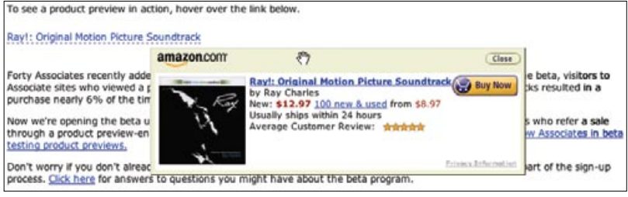

Slide 40
Anti Patterns – Non-Symmetrical Activation/Deactivation
The activation is slightly harder (pause, slight delay) than the deactivation (immediate when mouse is moved away)
It should take the same amount of effort to dismiss an overlay as it took to open it.

Slide 41
Tip:-
Make activation and deactivation symmetrical interactions.

Slide 42
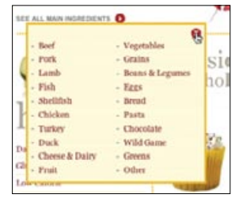
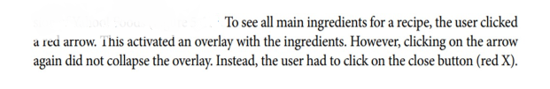

Slide 43
Anti Patterns – Needless Fanfare
There’s a needless animation that zooms the box up into place and then back down when the mouse moves away from a book.
The animation takes a full second to complete
Delays after activation

Slide 44
Tip:-
Once activated, show Detail Overlays immediately without fanfare

Slide 45
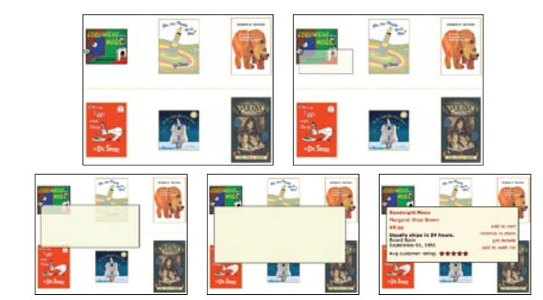

Slide 46
Anti Patterns – Hover and Cover
The overlay does not get in the way of moving to the next box shot
Even though the neighboring box is covered, a clear path to get an overlay on next shot box is provided.
Overlay contains the exact same information that already contained in page.
The shift causes annoying illusion

Slide 47
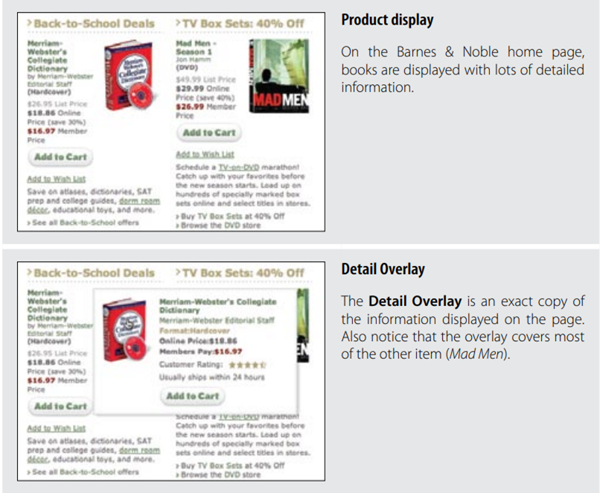

Slide 48
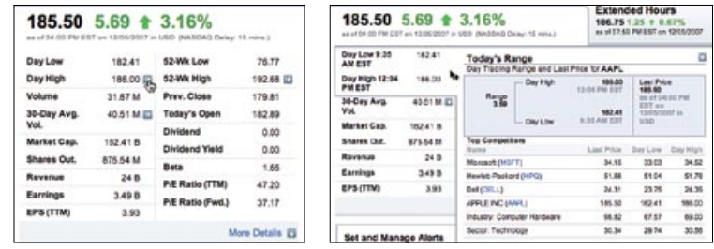
Finance provides additional information without preventing other navigation; the detail is activated by clicking on the blue arrow button

Slide 49
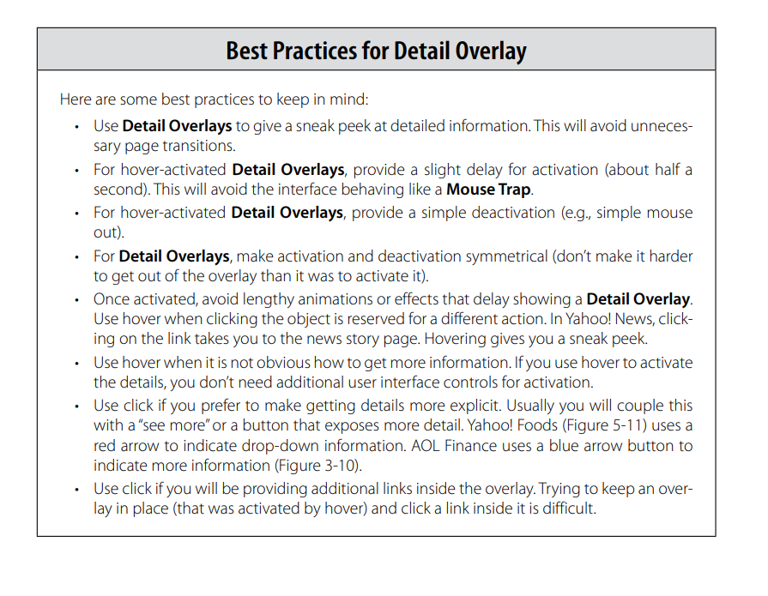

Slide 50
3. Input Overlays
Brings additional input information for field tabled into.
Usually an input form is displayed with simple prompt and input field.
Clicking on any input field wraps in an overlay – to provide additional information and instructions.
Clicking any where removes overlay.

Slide 51
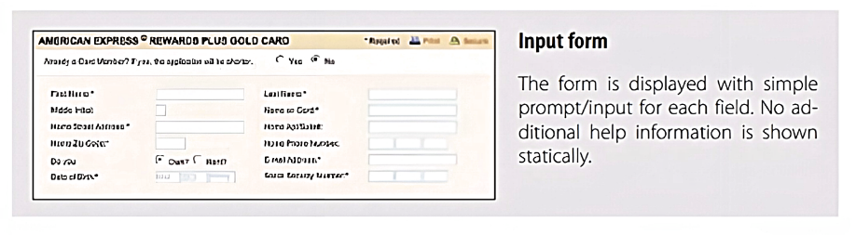
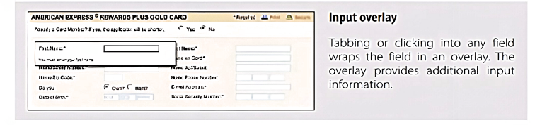
Input Overlay – Example

Slide 52
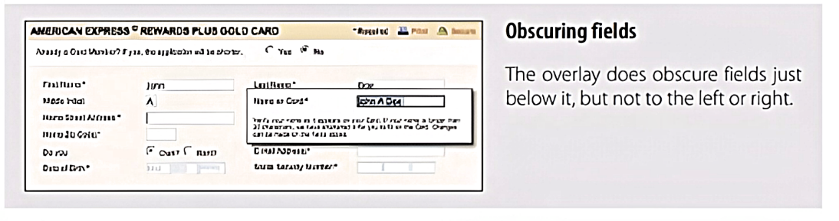
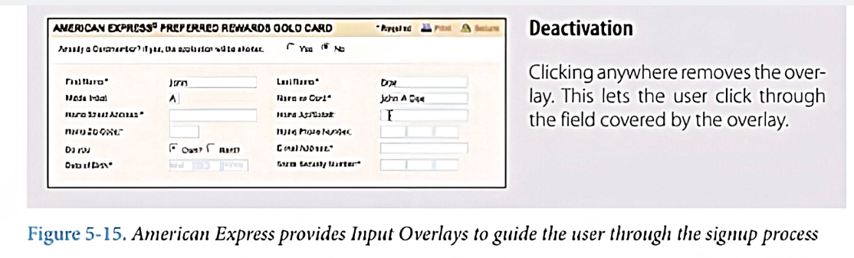

Slide 53
Input Overlay – Considerations
Few things to keep in mind when using Input Overlays.
Clear Focus
Display versus Editing

Slide 54
Input Overlay – Considerations – Clear Focus
As user tabs/clicks from field to field, field gets wrapped into an overlay – it provides additional information.
Allows to display a visually simple manner.
Thus, creates a clear focus on that field.

Slide 55
Input Overlay – Considerations – Display V/S Edit
when the Input Overlay is shown, the prompt is displayed in exactly the same manner as when the overlay doesn’t show.
It makes overlay feel even more lightweight.

Slide 56
Input Overlay – Anti patterns : Hover and Cover
What about the anti-pattern, Hover and Cover?
May cover other input fields.
Need to employ this overlay informs and get away with covering some fields during input.
If the overlay prompt were bold - the change would be slightly distracting and take the focus away from input.

Slide 57
Input Overlay – Anti patterns : Hover and Cover(cont.)
1. Field Traversal
Side – by – side traversal makes overlay for one input field does not obscure other field.
2. Tab Navigation
Helps to navigate to other fields even if they were covered.
3. One click deactivation
Clicking anywhere hides overlay.
Allows user easy to remove overlay and click on other field.

Slide 58
THANK YOU! - Questions

